Slide 1
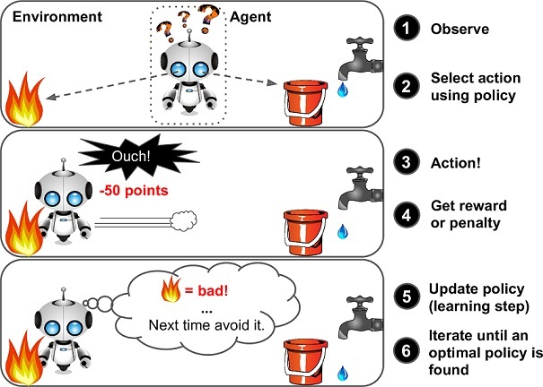
Reinforcement Learning
Sensor
Decision | Reward/ punishment
Without water | -50, bad
With water | +50, good
Actuator

